Slide 1

TARGET FOLDER
SRNTGT047
Poliarnie Zori Railway Bridge, SRN
SECRET - DCS WORLD
REL TO COALITION
SECRET - DCS WORLD
REL TO COALITION

Slide 2
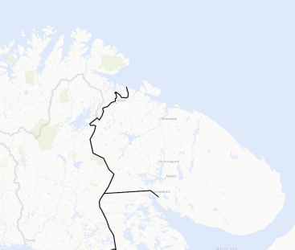
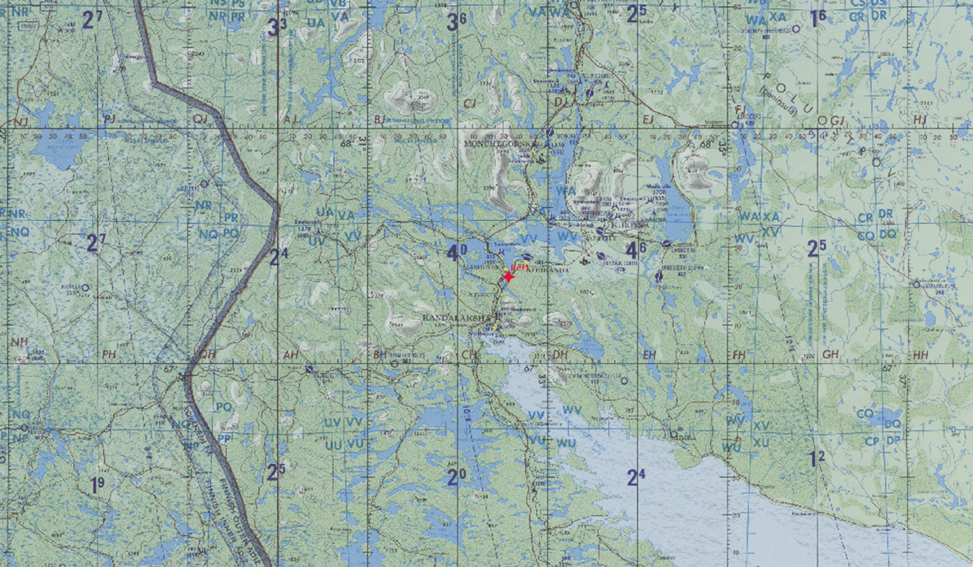
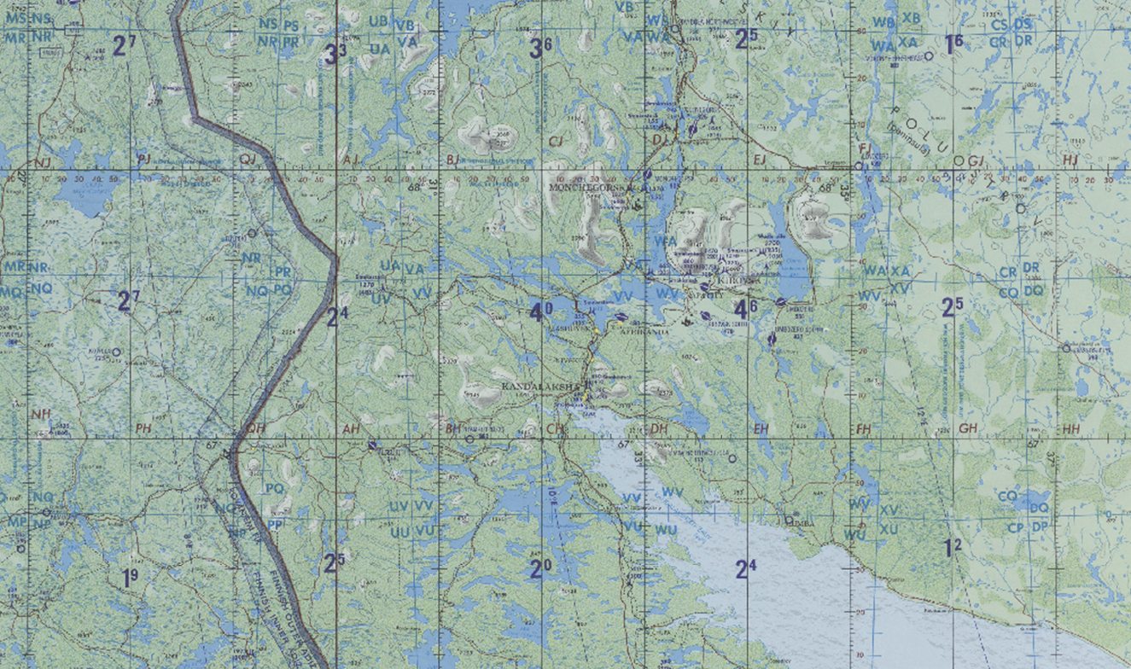
Poliarnie Zori Railway Bridge, SRN
OPAC CLASSIFIED REL TO CJTF-23
JOINT OPERATIONS GRAPHIC 1
MAP
OVERVIEW
BE: SRNTGT047 CATCODE: 10
MIDB GEO: N 67 22.748 E 032 31.471
ICOD: 2011-JUL-10 DOI:2011-JUN-20
DECL ON: 2061-JUL-10
N
.
Poliarnie Zori Railway Bridge
SRNTGT047

Slide 3
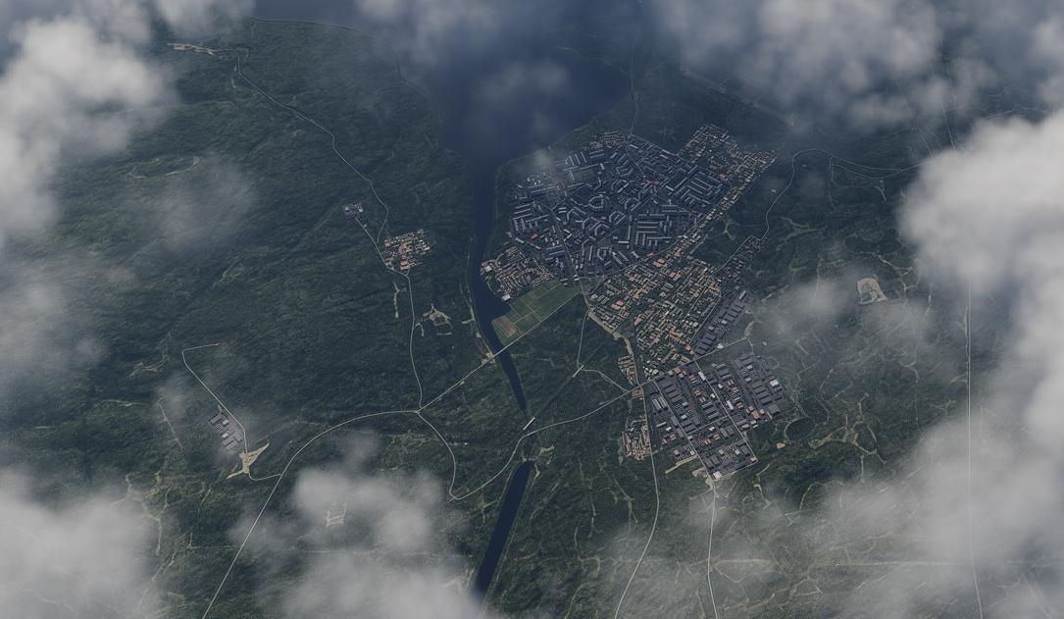
Poliarnie Zori Railway Bridge, SRN
OPAC CLASSIFIED REL TO CJTF-23
FACILITY OUTLINE GRAPHIC 1/1
MAP
OVERVIEW
BE: SRNTGT047 CATCODE: 10
MIDB GEO: N 67 22.748 E 032 31.471
ICOD: 2011-JUL-10 DOI:2009-APR-14
DECL ON: 2061-JUL-10
N
Railway Bridge SRNTGT047
Power Maintenance Facility
SRNTGT045
SAM Factory SRNTGT027 (underground)
SAM Factory SRNTGT027 (underground)

Slide 4
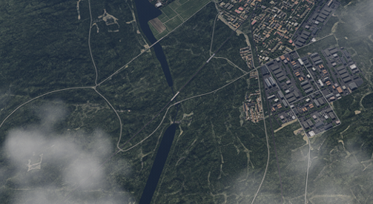
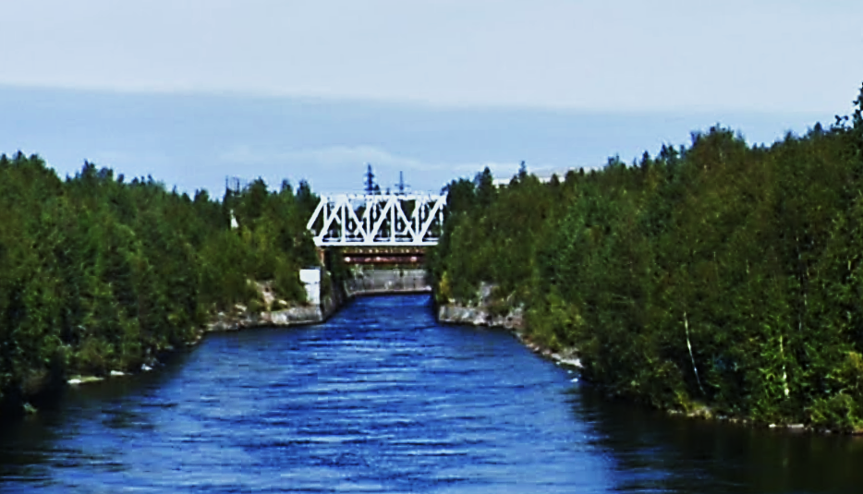
Poliarnie Zori Railway Bridge, SRN
OPAC CLASSIFIED REL TO CJTF-23
DESIRED POINT OF IMPACT GRAPHIC 1/1
MAP
OVERVIEW
BE: SRNTGT047 CATCODE: 10
MIDB GEO: N 67 22.748 E 032 31.471
ICOD: 2011-JUL-10 DOI:2001-SEP-16
DECL ON: 2061-JUL-10
N
DPI: SRNTGT047
RAILWAY BRIDGE
N 67 22.748 E 032 31.471
DPI MSL: - FT

Slide 5
Poliarnie Zori Railway Bridge, SRN
OPAC CLASSIFIED REL TO CJTF-23
WEAPONEERING OPTIONS 1/1
MAP
OVERVIEW
BE: SRNTGT047 CATCODE: 10
MIDB GEO: N 67 22.748 E 032 31.471
ICOD: 2011-JUL-10 DOI:2001-SEP-16
DECL ON: 2061-JUL-10
DPI | DESCRIPTION | TLE | WARHEAD | GUIDANCE | DESIRED EFFECT | IMPACT ANGLE | FUZING
1 | CENTRE PIER STEEL LATTICE BRIDGE | CAT 2 | 2000 lbs | METRIC | BLAST | 60-90 | 0ms

Slide 6
Poliarnie Zori Railway Bridge, SRN
OPAC CLASSIFIED REL TO CJTF-23
COLLATERAL DAMAGE ESTIMATION GRAPHIC 1/1
MAP
OVERVIEW
BE: SRNTGT047 CATCODE: 10
MIDB GEO: N 67 22.748 E 032 31.471
ICOD: 2011-JUL-10 DOI:2001-SEP-16
DECL ON: 2061-JUL-10
N
CER 250M / 812FT
DPI A
CDE1

Slide 7
Poliarnie Zori Railway Bridge, SRN
OPAC CLASSIFIED REL TO CJTF-23
COLLATERAL DAMAGES ESTIMATION 1/1
MAP
OVERVIEW
BE: SRNTGT047 CATCODE: 10
MIDB GEO: N 67 22.748 E 032 31.471
ICOD: 2011-JUL-10 DOI:2001-SEP-16
DECL ON: 2061-JUL-10
COLLATERAL DAMAGES WITHIN A 500M RADIUS
DESCRIPTION |  | CATCODE | MIDB GEOS | LOCATION | REMARKS
NO STRIKE ENTITIES WITHIN A 500M RADIUS
NSE ID | DESCRIPTION | CATCODE | MIDB GEOS | LOCATION | REMARKS

Slide 8
Poliarnie Zori Railway Bridge, SRN
OPAC CLASSIFIED REL TO CJTF-23
BATTLE DAMAGE ASSESSMENT GRAPHIC 1
MAP
OVERVIEW
BE: SRNTGT047 CATCODE: 10
MIDB GEO: N 67 22.748 E 032 31.471
ICOD: 2011-JUL-10 DOI:2001-SEP-16
DECL ON: 2061-JUL-10
POST-STRIKE
PRE-STRIKE
N
TARGET OBJECTIVE
DAMAGE/CHANGE ASSESSMENT
DPI:[XXXXXX]
BDA REMARK: [CLASSIFICATION] [DISSEMINATION] Assessment: Physical Damage/change, Collateral Damage, Functional Damage/change, Munitions Effectiveness, Reattack Recommendation, Additional/Collateral Effects

Slide 9

ACRONYMS
ACRONYM | MEANING | DEFINITION
BE | Basic Encyclopedia Number | Alpha/numeric code unique to an installation for incorporation within various national and tactical systems.
CATCODE | Category Code | The data Element that classifies the function and purpose of an installation or a facility.
MIDB | Modernized Integrated Database | A database comprised of information on facilities of military significance, military forces, and related equipment.
ICOD | Intelligence Cut Off Date | The date of the latest intelligence data inputted to a feature.
DOI | Date of Image | Date on which a geospatial or intelligence-related image was captured.
CE | Critical Element | An element of an entity or object that enables it to perform its primary function.
PV CHAR | Physical Vulnerability Characteristic | Standardized alphanumeric code describing the physical and structural properties of a target.
JDPI | Joint Desired Point of Impact | A unique, alphanumeric coded aimpoint identified by a three dimensional mensurated point. It represents a weapon or capability desired point of impact or penetration.
CE90 | Circular Error at 90% | 90 percent confidence level in the horizontal plane.
LE90 | Linear Error at 90% | 90 percent confidence level in the vertical dimension
MSL | Mean Sea Level | Elevation above Earth reference geoid.
AGL | Above Ground Level | Elevation above ground surface.
NCC | Nearest Collateral Concern | Closest non-targeted structure, area, or entity near a planned point of impact that may be at risk of unintended damage during a military strike.
CER | Collateral effects radius | Radius within which collateral damage might happen based on the weapon's characteristics, the target environment, and other operational factors.
CDE | Collateral damage estimate | Systematic process used in military targeting to evaluate the potential for unintended damage or harm to non-combatant entities, structures, or personnel as a result of a planned strike.
NSE | No Strike Element | Specific entities, locations, or objects that are protected from intentional targeting under the Law of Armed Conflict (LOAC) or by operational policy.

